Slide 1
Springboard Capstone Project
Sentiment Analysis by Falguni Mehta
Mentor : Shmuel Naaman

Slide 2
Sentiment Analysis
Sentiment Analysis is the process of determining whether a piece of writing is positive, negative or neutral. It’s also known as opinion mining or deriving the opinion or attitude of a speaker. A common use case for this technology is to discover how people feel about a particular topic.
The goal of this project is to classify the sentiment of each sentence extracted from social media blogs into "positive" or "negative" classification (sentiment classification).

Slide 3
Dataset
Source : https://inclass.kaggle.com/c/si650winter11/data
The training data contains 7086 sentences, already labeled with 1 (positive sentiment) or 0 (negative sentiment).
The test data contains 33052 sentences that are unlabeled.
Note: This Kaggle competition was completed so could not verify my predictions by submitting the test dataset onto Kaggle.

Slide 4
Approach
Setup & Data Preparation
Install and load the necessary libraries in R
The most important library required for sentiment analysis is the Text Mining (“tm”) library in R
Clean the tweets
Remove the retweets
References to screen names
Remove the hashtags
Remove the numbers
Remove the punctuation
Remove the URLs
After cleaning the training dataset was reduced to about 7000 rows

Slide 5
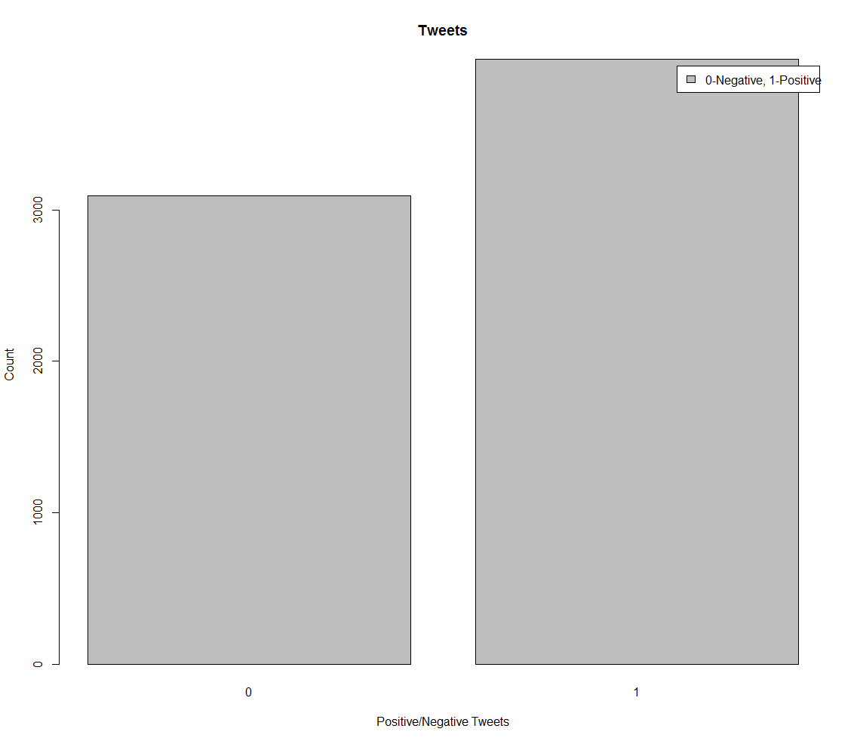
Approach
Exploratory Data Analysis
Created a Bar Plot to check the distribution of the positive and negative tweets

Slide 6
Approach
Creating the Document-Term Matrix (DTM)
For the analysis we will use the frequency of individual words in a sentence as features.
A Document-Term Matrix from the “tm” package contains the sentences in rows and the words in columns; each entry in the matrix indicates the number of occurrences of that particular word in that particular review.

Slide 7
Approach
Remove the Stop Words
Some extremely common words like a, an, the, etc which would appear to be of little value are excluded from the vocabulary entirely. These words are called stop words .
Remove the Stop Words
Some extremely common words like a, an, the, etc which would appear to be of little value are excluded from the vocabulary entirely. These words are called stop words .

Slide 8
Approach
Stemming
For grammatical reasons, documents are going to use different forms of a word, such as organize, organizes, and organizing.
The goal of both stemming is to reduce inflectional forms and sometimes derivationally related forms of a word to a common base form. For instance:
am, are, is be
car, cars, car's, cars' car
Remove the Sparse Term
We don’t want to analyze every single word in the sentence, because very rare words will increase the size of the DTM while having little predictive power. So we’ll only keep in our DTM words that appear in at least a certain percentage of all reviews, say 0.5%. This is controlled by the “sparsity” parameter in the following code, with sparsity = 1-0.005 = 0.995

Slide 9
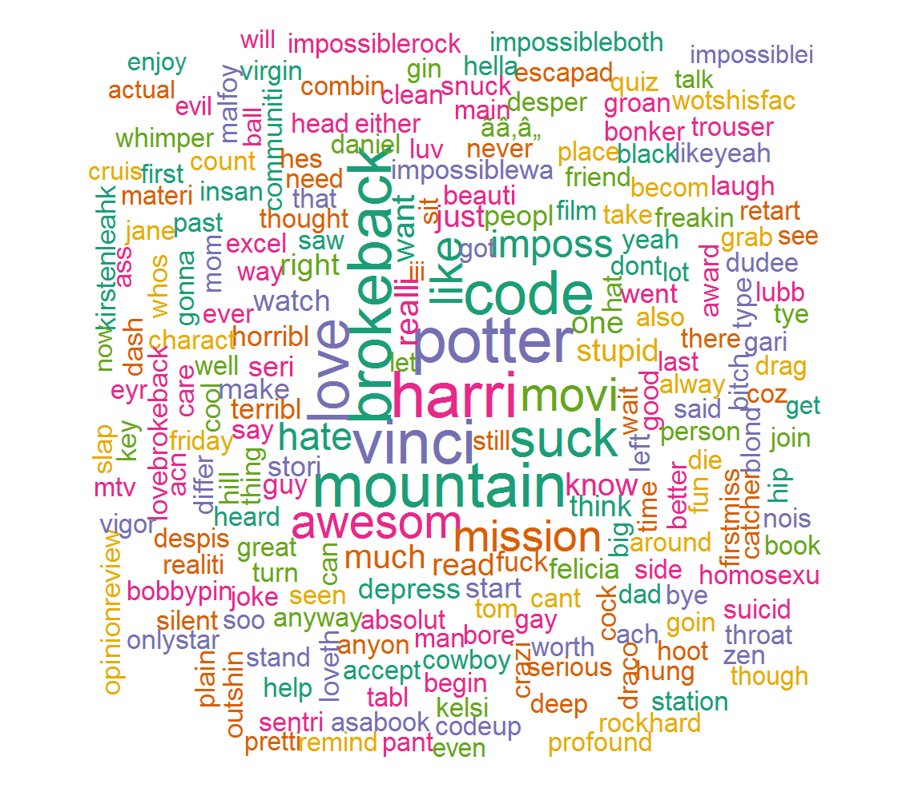
Approach
Create a Word Cloud
A word cloud is a text mining method that allows to highlight the most frequently word used in the dataset. It is also referred to as a text cloud or tag cloud

Slide 10
Approach
Split the data in training set and testing data
The data is partitioned into training and testing set using the sample.split function of R.
70% of the data is used to train the model and 30% of the data is used to test the model

Slide 11
Approach
Predictive Analysis
Naïve Bayes
The Naive Bayes Classifier technique is based on the Bayesian theorem and is particularly suited when the dimensionality of the inputs is high.
Random Forests
A random forest is an ensemble of decision trees which will output a prediction value.

Slide 12
Approach
Accuracy
Naïve Bayes
Accuracy is 0.84 or 84%
Random Forests
Accuracy is 0.98 or 98%

